Slide 1


“Information Security”
Lecture # 13
Dr. Engr. M Malook Rind
Ph.D (I.T), ME (CSN), MBA (MIS), BE (CS)
CCNA, CCNP, Juniper Certified.
Professor (Computer Science)

Slide 2

Contents
IoT Attacks and Countermeasures
Dr. M Malook Rind Information Security Lecture 13

Slide 3
IoT Attacks and Countermeasures
Understanding IoT Concepts and IoT Attacks
IoT Attack Countermeasures and Security Tools
Dr. M Malook Rind Information Security Lecture 13

Slide 4
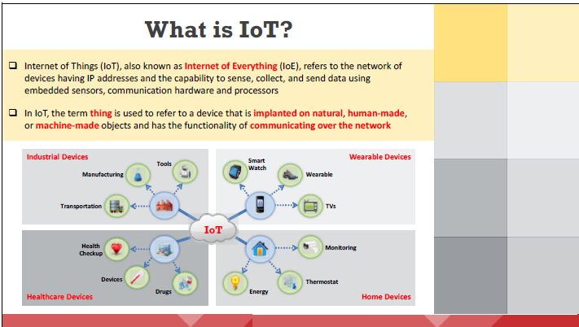
Understanding IoT Concepts
Dr. M Malook Rind Information Security Lecture 13

Slide 5
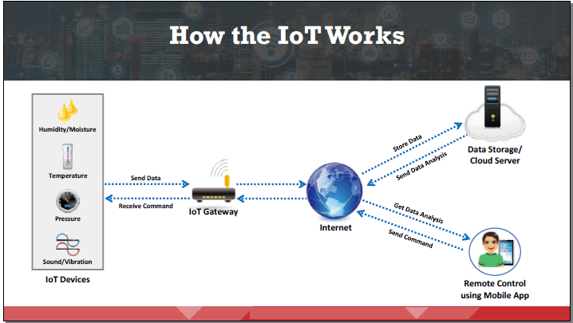
Understanding IoT Concepts
IoT technology includes four primary systems: IoT devices, gateway systems, data storage systems using cloud technology, and remote control using mobile apps.
Dr. M Malook Rind Information Security Lecture 13

Slide 6
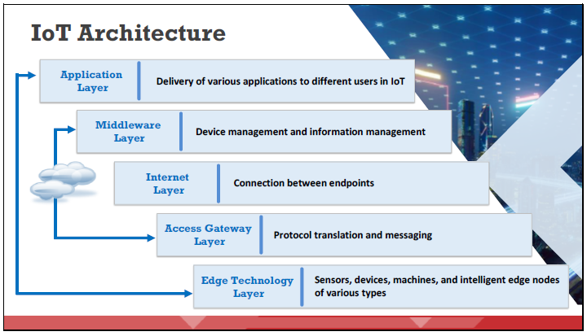
Understanding IoT Concepts
The IoT architecture includes several layers, from the Application layer at the top to the Edge Technology layer at the bottom.
Dr. M Malook Rind Information Security Lecture 13

Slide 7
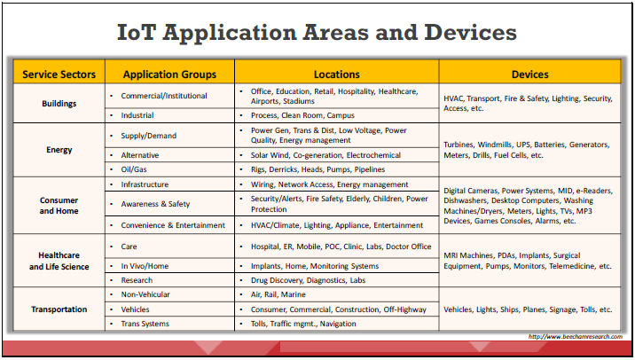
Understanding IoT Concepts
IoT devices have a wide range of applications.
Dr. M Malook Rind Information Security Lecture 13

Slide 8
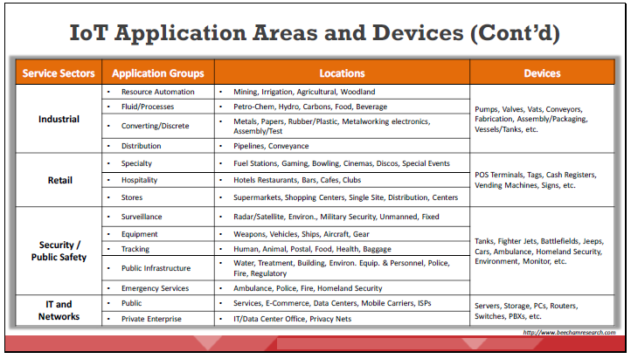
Understanding IoT Concepts
Dr. M Malook Rind Information Security Lecture 13

Slide 9
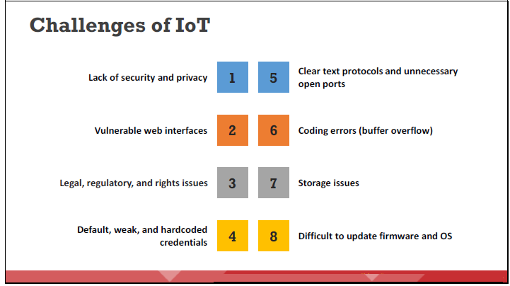
IoT Threats and Attacks
With numerous applications and features but a lack of basic security policies, IoT devices are currently easy prey for hackers.
Dr. M Malook Rind Information Security Lecture 13

Slide 10
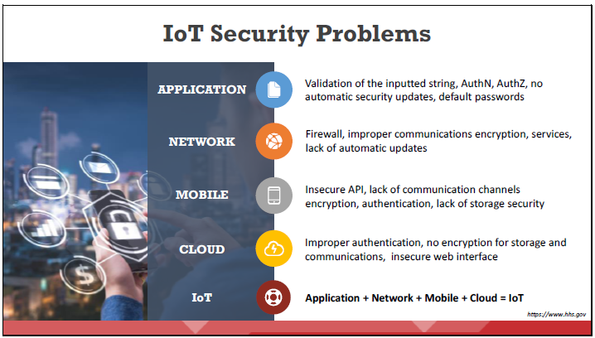
IoT Threats and Attacks
Potential vulnerabilities in the IoT system can result in major problems for organizations. Most IoT devices come with security issues such as the absence of a proper authentication mechanism or the use of default credentials, absence of a lock-out mechanism, absence of a strong encryption scheme, absence of proper key management systems, and improper physical security.
Dr. M Malook Rind Information Security Lecture 13

Slide 11
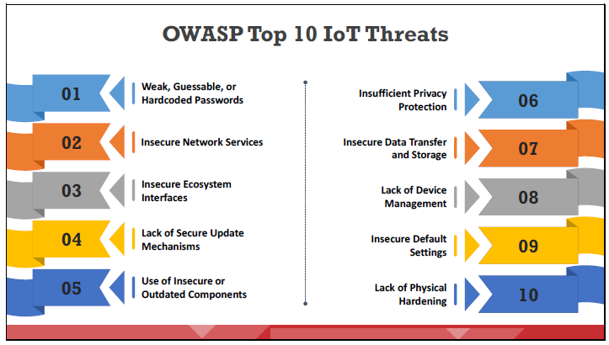
IoT Threats and Attacks
The Top 10 IoT threats, according to the Open Web Application Security Project (OWASP), are:
Dr. M Malook Rind Information Security Lecture 13

Slide 12
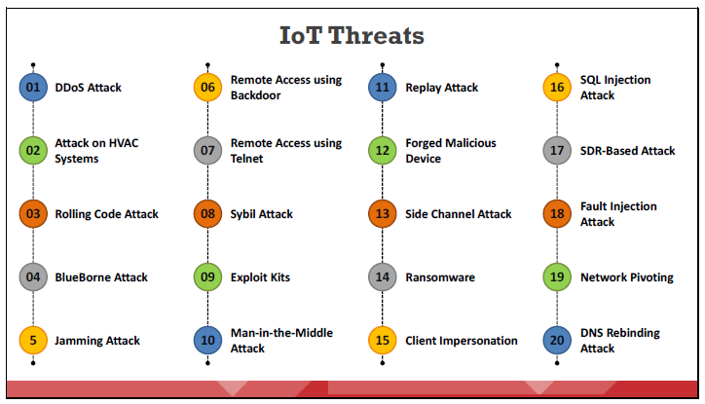
IoT Threats and Attacks
Listed below are some types of IoT attack:
Dr. M Malook Rind Information Security Lecture 13

Slide 13
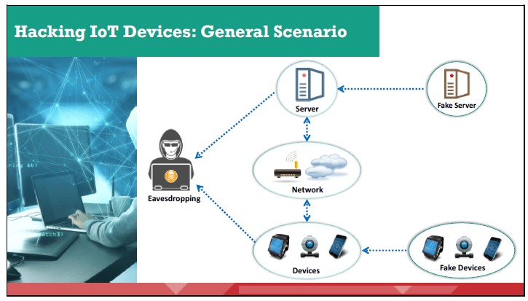
IoT Threats and Attacks
Improper security infrastructure might lead to the following unwanted scenarios
An eavesdropper intercepts communication between two endpoints and discovers the confidential information that is sent across. He/she can misuse that information for his/her own benefit.
A fake server can be used to send unwanted commands to trigger unplanned events. For example, some physical resources (water, coal, oil, electricity) could be sent to an unknown and unplanned destination, etc.
A fake device can inject a malicious script into the system to make it work as instructed by the device. This may cause the system to behave inappropriately and dangerously.
Dr. M Malook Rind Information Security Lecture 13

Slide 14
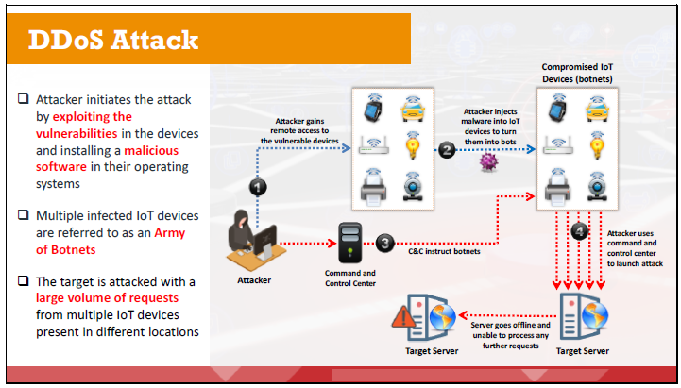
IoT Threats and Attacks
A distributed denial-of-service (DDoS) attack is an attack in which multiple infected systems are used to bombard a single online system or service, rendering the server useless, slow, or unavailable for a legitimate user for a short period of time.
Dr. M Malook Rind Information Security Lecture 13

Slide 15
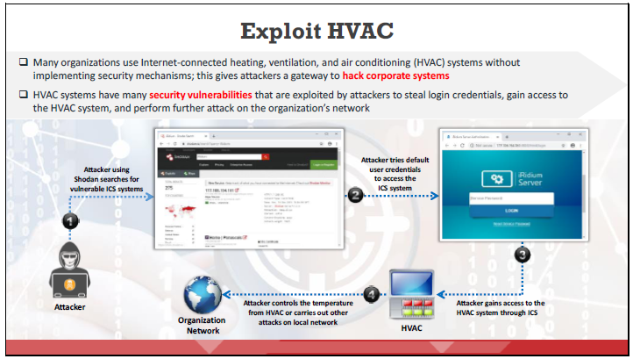
IoT Threats and Attacks
Dr. M Malook Rind Information Security Lecture 13

Slide 16
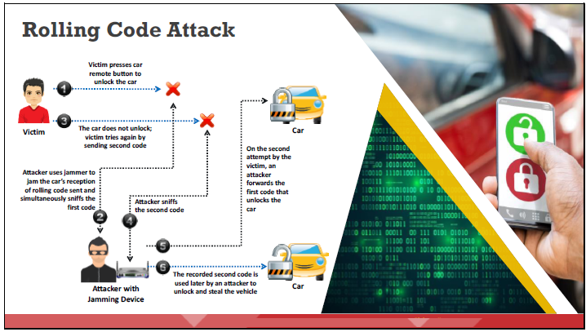
IoT Threats and Attacks
The code that locks or unlocks a car or garage is called a rolling code or hopping code.
It is used in a keyless entry system to prevent replay attacks.
An eavesdropper can capture the code transmitted and later use it to unlock the garage or vehicle.
Dr. M Malook Rind Information Security Lecture 13

Slide 17
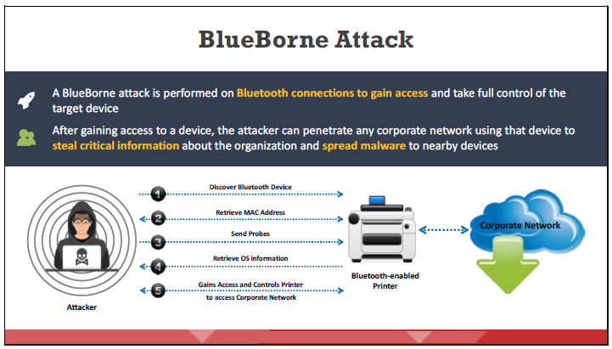
IoT Threats and Attacks
BlueBorne is a collection of various techniques based on the known vulnerabilities of the Bluetooth protocol.
After gaining access to one device, an attacker can penetrate any corporate network using that device to steal critical information from the organization and spread malware to nearby devices.
Dr. M Malook Rind Information Security Lecture 13

Slide 18
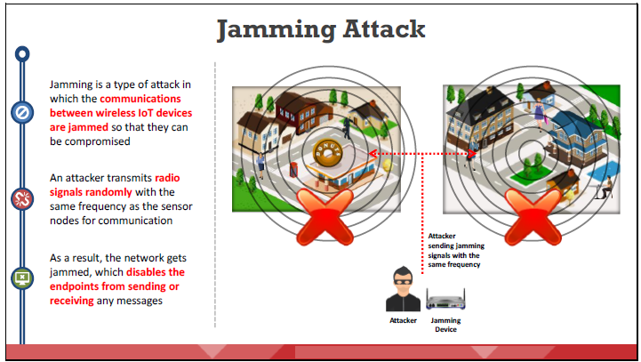
IoT Threats and Attacks
Dr. M Malook Rind Information Security Lecture 13

Slide 19
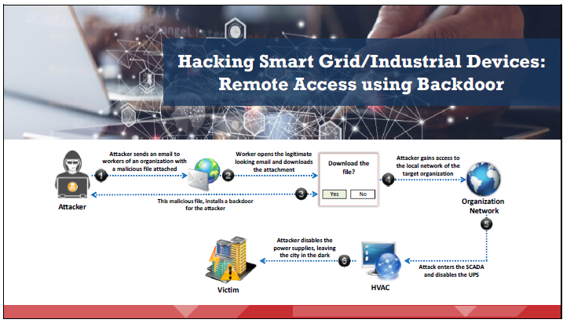
IoT Threats and Attacks
Dr. M Malook Rind Information Security Lecture 13

Slide 20
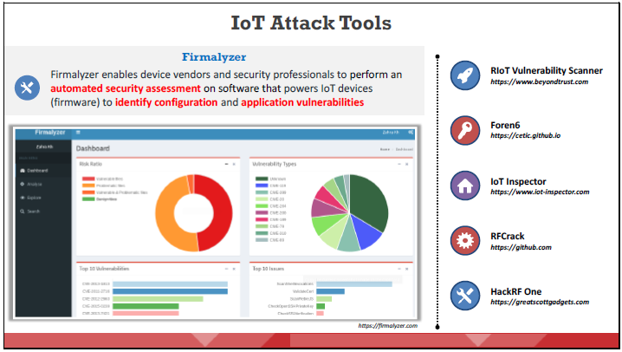
IoT Threats and Attacks - IoT Attack Tools
Some of the IoT hacking tools used by attackers to exploit target IoT devices and networks to perform various attacks such as DDoS, jamming, and BlueBorne attacks are:
Dr. M Malook Rind Information Security Lecture 13

Slide 21
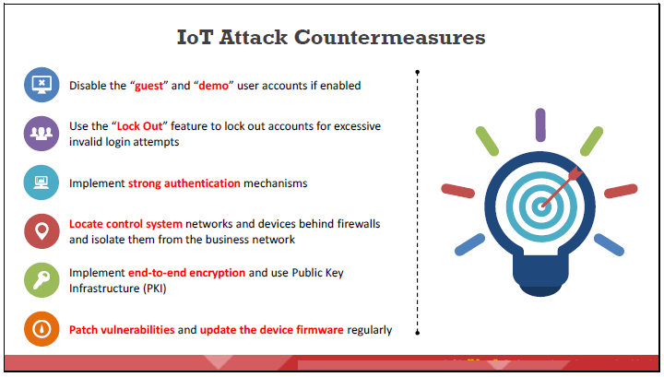
IoT Threats and Attacks - IoT Attack Countermeasures
Dr. M Malook Rind Information Security Lecture 13

Slide 22
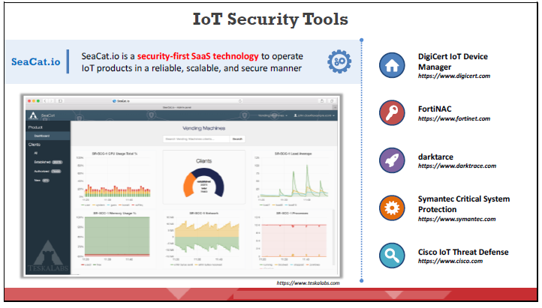
IoT Threats and Attacks - IoT Attack Countermeasures
The use of IoT security tools helps organizations to significantly limit security vulnerabilities, thereby protecting the IoT devices and networks from different kinds of attacks.
Dr. M Malook Rind Information Security Lecture 13

Slide 23
Thanks
Dr. M Malook Rind Information Security Lecture 13

